Slide 1

Minor Project
Submitted By: Kanika Soni

Slide 2
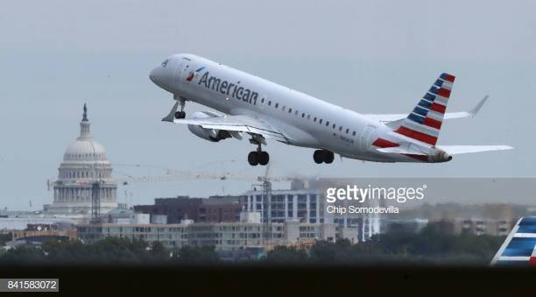

Background
For my minor project after Term2 ,I have chosen the data set of flight details for year 2013
It covers the flight details of 16 different carriers/ airlines from three different airports in New York to 106 different destinations within US
I selected this data set as it is a huge data base with different column types ; 9 numerical and 5 categorical columns
There are many Date and Time columns with different set of information but all were of Data Type Int or Float64

Slide 3

Columns Dictionary
Column Name | Description | Data Type
year, month, day | Date of departure splited in three columns | int64
dep_time, arr_time | Actual departure and arrival times (format HHMM or HMM), local tz. | float64
sched_dep_time,sched_arr_time | Scheduled departure and arrival times (format HHMM or HMM),local tz. | Int64
dep_delay, arr_delay | Departure and arrival delays, in minutes. Negative times represent early departures/arrivals. | float64
hour, minute | Time of scheduled departure broken into hour and minutes. | int64
Carrier | Two letter carrier abbreviation | non-null object
Tailnum | Plane tail number | non-null object
Flight | Flight number | int64
origin,dest | Origin & Destination cities | non-null object
air_time | Amount of time spent in the air, in minutes | Float64
distance | Distance between airports, in miles | Int64
time_hour | Scheduled date and hour of the flight as a POSIXct date | non-null object

Slide 4


Steps of Data Analytics - 1
Imported the data set from gitlab repository . There were close to 320 K data rows
Executed the pandas profiling on the data set and studied the profile report.
Following were the key observations:
Total 19 columns in the data set
There were no duplicate rows
There were 46K missing cells which sums up to 0.7% of the total data set
There were few columns which were highly correlated with each other such as “dep_delay” is highly correlated with arr_delay, and “distance” is highly correlated with air_time
Deleted all the Nan values form the data set as it was only 0.7% of total data set
Converted the numeric month values to month names

Slide 5

Steps of Data Analytics - 2
Converted the following columns from int or float data type to time stamp:
dep_time
arr_time
sched_dep_time
sched_arr_time
Replaced the two letter code of Carrier with Airlines Name . Fetched this information from Wikipedia .
Source: https://en.wikipedia.org/wiki/List_of_airline_codes
Plotted Univariate , Bi Virate & Multivariate graphs
Executed post profiling on Data Set.

Slide 6

GRAPHS

Slide 7
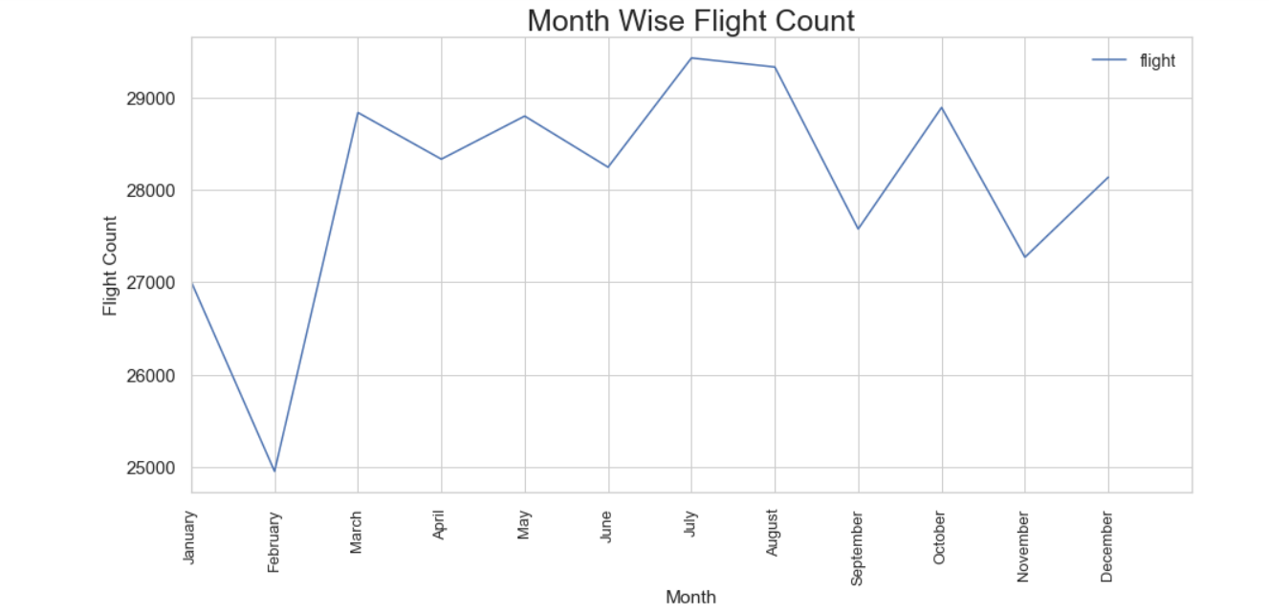

Month-wise Flight Count - Line Graph
This graph shows that flight count for entire year varies between 25000 flights to 29000 flights per month

Slide 8
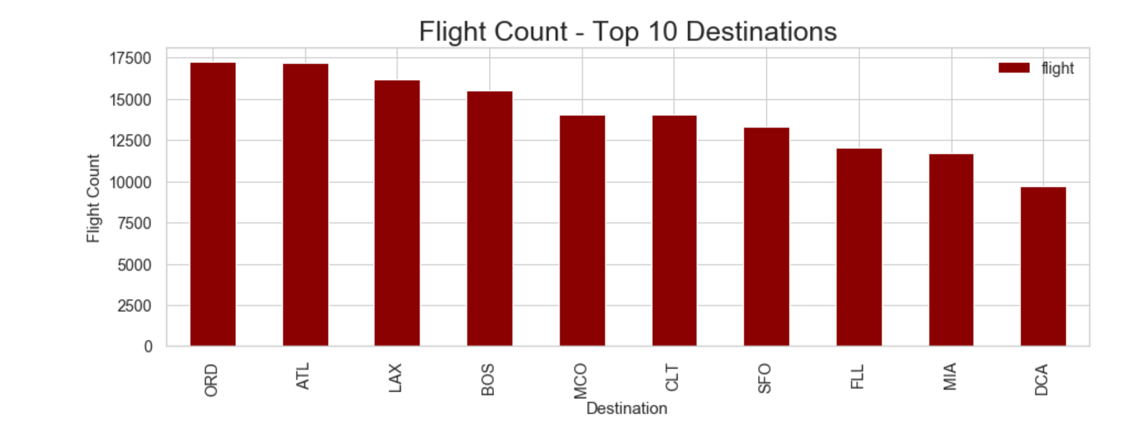

Top Ten Busy Destinations - Bar Graph
This graph shows that flight count for entire year varies between 25000 flights to 29000 flights per month

Slide 9
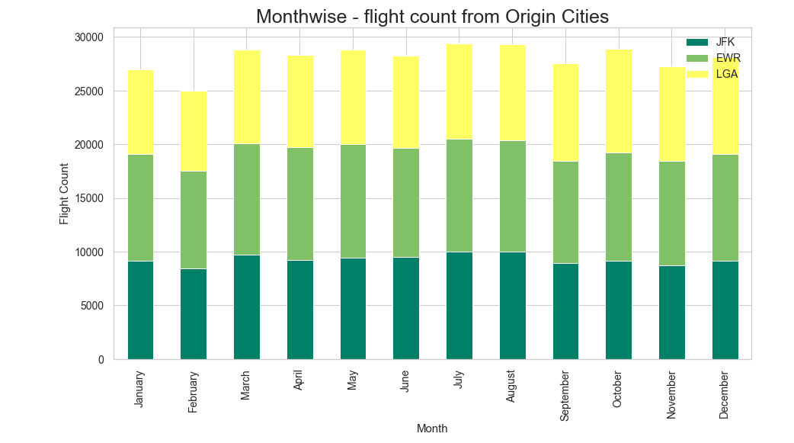

Month-wise Flight Count from Origin Cities – Stacked Bar Chart
This graph shows that flight count for entire year varies between 25000 flights to 29000 flights per month

Slide 10
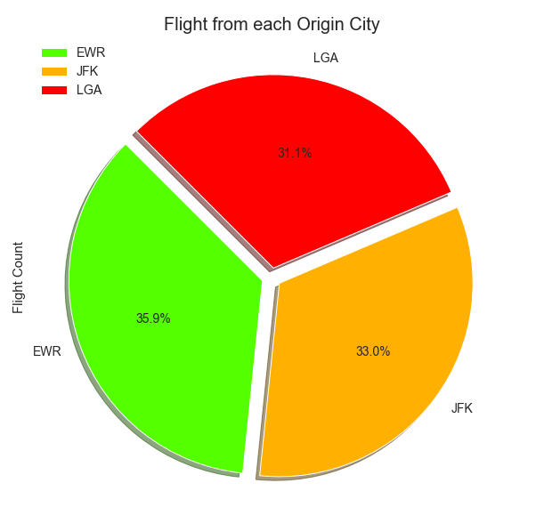

Flight distribution between different Origin Airport
This graph shows that flight count for entire year varies between 25000 flights to 29000 flights per month

Slide 11
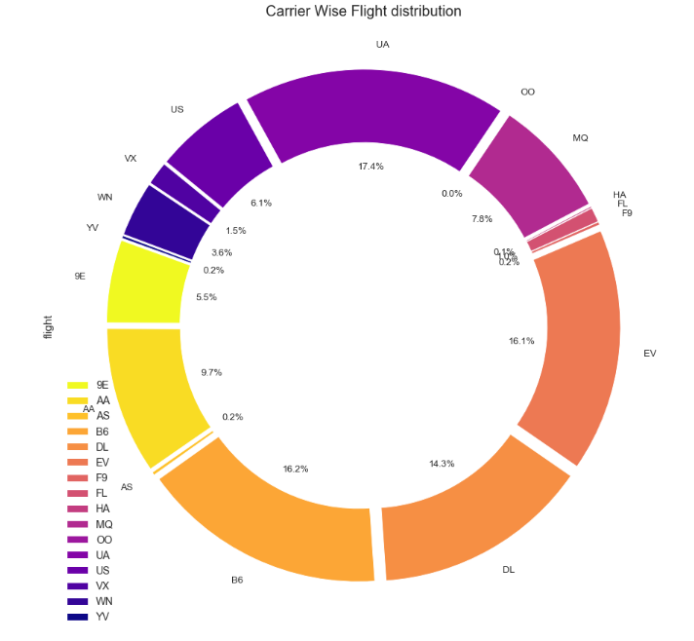

Carrier-wise – Flight Distribution

